Slide 1
Chapter 3 Digital Entertainment

Slide 2
Table of Contents
Introduction
The Effects of Digital Entertainment Technology
Harms of Computer Games
Benefits of Computer Games
Digital Equipment – Part of the Modern Family
Does Television Cause Adverse Social Behaviour?
Creating Monsters – Do Computer Games make People Violent?
Do Computer Games Fuel Addiction and Gambling?
Game Development Grows up – The Hidden Agenda

Slide 3
Introduction

Slide 4
Introduction
kids spend many hours watching tv, playing video games and listening to music that their ‘media use’ could qualify as a full-time job
But kids are not the only consumers of digital entertainment:
average age of computer and video game players is 33
average age of frequent game purchasers is 40
over 25% are over the age of 50

Slide 5
Introduction
All digital entertainment is copyrighted material
Computer games
Music
Movies
TV
The video games industry in particular has exhibited rapid growth – video game titles are now bringing in more revenue than films released in the cinema
This chapter examine some of the latest applications and trends in the entertainment industry and the social implications facing the information society.

Slide 6
The Effects of Digital Entertainment Technology
The Toy Town Divide

Slide 7
The Toy Town Divide
The Effects of Digital Entertainment Technology
Video and computer games are an expensive commodity although they are ‘cheaper’ to have the latest updated version with more processing power than electronic toys
Not many parents afford latest electronic toys and thus contribute to family unrest and a potential ‘playground digital divide’ with possible social exclusion from peer groups.

Slide 8
The Toy Town Divide
The Effects of Digital Entertainment Technology
Young adults and children’s demand for digital items and products may encourage software piracy, unauthorized downloading of music files, etc.
There is also considerable evidence indicating that the visual impact of digital toys, mobile phones and electronic music devices such as iPods has increased the potential for theft and mugging
E.g. it has been warned that thieves focus on those wearing white headphone but user continue wearing white headphones as a fashion and lifestyle statement.
Notes:
Mugging – robbery

Slide 9
The Toy Town Divide
The Effects of Digital Entertainment Technology
Explosion in digital and visual communication issues:
There is expectation that every household should have a range of broadcast and digital technologies available for use by the family.
This creates the potential for a range of social divisions within a single household
Games and games technology yet has untested long-term social implications
Notes:
Mugging – robbery

Slide 10
The Effects of Digital Entertainment Technology
Boys and Girls Come out to Play: Stereotyping

Slide 11
Boys and Girls Come out to Play: Stereotyping
The Effects of Digital Entertainment Technology
Computer gaming has traditionally been regarded as a predominantly male activity.
Recent statistic?
Notes:
Mugging – robbery

Slide 12
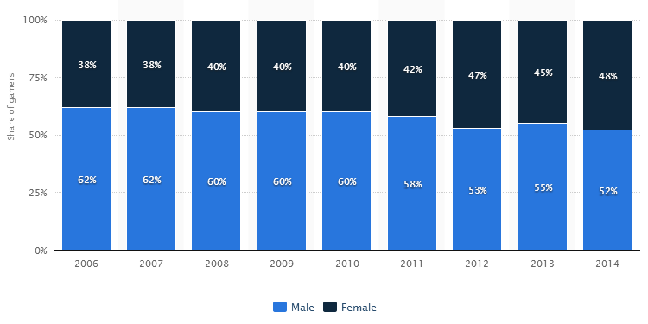
Boys and Girls Come out to Play: Stereotyping
The Effects of Digital Entertainment Technology
Distribution of computer and video gamers in the United States from 2006 to 2014, by gender
Resource: http://www.statista.com/statistics/232383/gender-split-of-us-computer-and-video-gamers/

Slide 13
Boys and Girls Come out to Play: Stereotyping
The Effects of Digital Entertainment Technology
adult women play computer games do not want stereotypical games related to traditional gender-related issues such as cooking, sewing & baking
women like goal-driven games with an underlying narrative to indicate that they are doing something worthwhile
E.g. within a particular gaming scenario the primary aim of women players may be to ‘save the scientist’ with ‘killing the enemy’ being a necessary part of this.

Slide 14
Boys and Girls Come out to Play: Stereotyping
The Effects of Digital Entertainment Technology
Conversely, in the same scenario, evidence indicates that males would tend to be more focused on ‘killing the enemy’ with the goal of ‘saving the scientist’ being of secondary importance.
Differences may well be linked to the fact that women are not encouraged to express aggression in public & less likely to feel comfortable with games involving combat or war

Slide 15
Boys and Girls Come out to Play: Stereotyping
The Effects of Digital Entertainment Technology
Two of the most popular games favoured by both men and women are The Sims and Sim City - both genders like to build new structures
But women tend to focus more on developing and enjoying the social context that surrounds the new environment

Slide 16
Boys and Girls Come out to Play: Stereotyping
The Effects of Digital Entertainment Technology
Future development of gaming technology will be predicated on cross-gender appeal
Technical game development arena is still very much dominated by men
This will change over time as more women are attracted, through their increased participation in playing games, to follow a career in the game development
Another area of gaming that is growing in popularity is the ‘mobile’ games market both to men and women.

Slide 17
Harms of computer games

Slide 18
Curse of the Couch-Potato Children
Health-Related Issues
Computer games displace active physical pursuits i.e. sport and recreation.
Consequences:
Obesity
Ill health

Slide 19
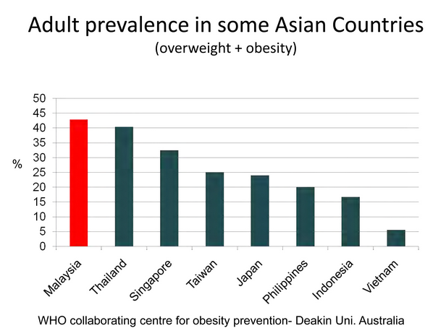
Curse of the Couch-Potato Children
Health-Related Issues
British medical journal, The Lancet, showed that 49% of women and 44% of men in Malaysia were found to be obese.
Source: http://mymedicnews.com/industry-news/2552-malaysia-s-obesity-rate-highest-in-asia/#.VLauVdLF-7M

Slide 20

Curse of the Couch-Potato Children
Health-Related Issues
Childhood obesity affects one in seven children in Malaysia, according to recent statistics from the NHMS carried out in 2006 and 2011. – Reuters
http://www.thestar.com.my/Lifestyle/Health/2014/04/13/Weight-issues-Fighting-flab-from-young/

Slide 21
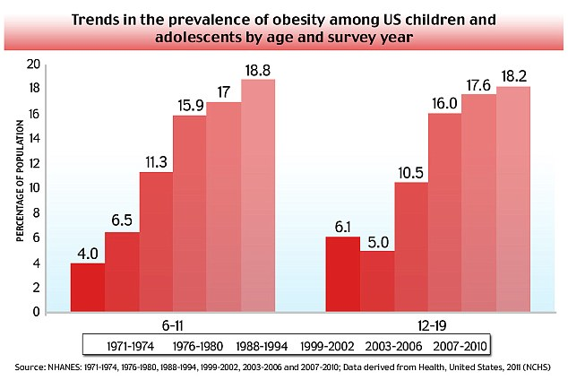
Curse of the Couch-Potato Children
Health-Related Issues
Source: http://www.dailymail.co.uk/news/article-2540248/Study-reveals-parents-poor-eating-habits-blame-childhood-obesity-NOT-fast-food.html

Slide 22
Curse of the Couch-Potato Children
Health-Related Issues
Main factors to obesity:
Eating lifestyle
Digital entertainment e.g. TV watching, games
Obesity contributes to:
9 years lifespan reduction
Diabetes (even as young as 13 years old)
Heart attacks
strokes

Slide 23
Curse of the Couch-Potato Children
Health-Related Issues
Promotes healthy lifestyle through entertainment (games):
LazyTown: superhero Sportacus battles Robbie Rotten, a junk-food-eating villain
Nintendo Wii games console: innovative controllers and range of sports-related games, e.g. swing golf club or throwing a ball instead of pressing buttons.

Slide 24

Physical Problems
Health-Related Issues
Deep-vein thrombosis (DVT)
formation of a blood clot (thrombus) in a deep vein, predominantly in the legs
Computer gaming and excessive time spent watching TV may well be contributing to the increasing occurrences of DVT, particularly in young people.
Image source: Internet

Slide 25
Physical Problems
Health-Related Issues
Sleep problems:
children who watch huge amounts of TV may develop sleep problems as they grow older.
Scientists monitored 759 people of the ages of 14-22. None of the 14-year-olds had problems sleeping, those who had watched 3 hours of TV a day were more likely to have problems falling asleep or waking during the night when they reached 16 or 22 years
possible explanations
viewing TV leaves them in a state of heightened alertness and physiological stimulation thereby preventing them from falling asleep with ease
The bright light of the television may also disturb their sleep–wake cycle.

Slide 26
Physical Problems
Health-Related Issues
Nintendonitis
repetitive strain injury (RSI) brought by excessive gaming
One of the first recorded cases in 1999, a child (young gamer) was treated in local hospital after having played computer games continuously throughout the Christmas holidays.

Slide 27
Physical Problems
Health-Related Issues
Headache
Caused by playing computer games for long periods of time in badly lit rooms with poor posture and being too close to the computer screen
Video games incorporating flashing lights, special figure patterns, scene changes and screen flicker can trigger epileptic seizures → epilepsy
Although there is no evidence to prove that computer games can cause epilepsy but it may well be that it is the trigger for an episode.

Slide 28
Physical Problems
Health-Related Issues
Sudden Death:
South Korean man played computer games continuously for 50 hours without stopping for food or sleep.
A mother from Louisiana unsuccessfully sued the games manufacturer Nintendo, after her son died during a marathon games-playing session where he hit his head on a table after suffering a seizure while playing with the console.
2012, an 18-year-old collapsed and died at an internet cafe after playing an online computer game (Diablo 3) for 40 hours straight due to cardiovascular problems (sitting in the same position for too long)

Slide 29
Benefits of Computer Games

Slide 30
Harnessing the Power of the Brain
Power to the Player – Benefits of Computer Games
To help with attention deficit disorder (ADD), video games have been used to train children for their brains to concentrate and focus their attention
video games reduce nausea in paediatric cancer patients receiving chemotherapy & reducing their perceived levels of pain.
handheld video game therapy treats compulsive self-harming behaviour in young children

Slide 31
Education and Learning
Power to the Player – Benefits of Computer Games
Benefits of playing educational games:
Math
Reading
Hand-eye coordination
Good reaction times
Better social interaction
Better pattern and rule generation and hypothesis testing and generalization
Better spatial visualization
Developed sense of achievement
Listening skills
Study skills

Slide 32
The Silver Gamers
Power to the Player – Benefits of Computer Games
Advantageous effects after playing video games for a period of time (among elderly adults):
Faster reaction times
Improved self-esteem
Improved perceptual motor skills
Better concentration
Focus of attention
Improved coordination
Better driving habits
Fewer accidents in the home
Soothe the pain of arthritis

Slide 33
Digital Equipment – Part of the Modern Family

Slide 34
Digital Equipment – Part of the Modern Family
Health-Related Issues
Problems of using TV as a virtual ‘baby-sitter’:
Creates a generation of children whose speech and behaviour is t an all-time low
Young children exhibit behaviour indicating highly undeveloped social skills e.g. inability to fasten buttons, use a knife and fork or eat and drink at a table
Develop speech and communication difficulties
Difficulty speaking clearly and understanding instructions

Slide 35
Digital Equipment – Part of the Modern Family
Health-Related Issues
As a society we are becoming addicted to electronic equipment such as TV and computers and this addiction is being passed on to our children
Children now are forming closer relationships with their computers than with other humans
A survey found that one in five youngsters said that the time they spent at the keyboard made them happier than when they were with family and friends.
Some children treat computer as family member
Youngster call PC a ‘trusted friend’ and become jealous when their PC being used by someone else.
Some believe that machine has a personality of its own.

Slide 36
Digital Equipment – Part of the Modern Family
Health-Related Issues
Conversely, same rich media used properly within the household may form an integral part of the education process, encouraging study skills and widening the horizon of the young individual.

Slide 37
Does TV Cause Adverse Social Behaviour?

Slide 38
Does TV Cause Adverse Social Behaviour?
Health-Related Issues
Since 1960, over 3500 research studies undertaken to examine the relationship between viewing media violence and its association with actual violent behaviour.
In all but 18 of these studies, increased aggression has been linked to watching TV
Effects of media violence: aggressive behaviour, desensitization to violence, anxiety, depression, sleep loss, nightmares

Slide 39
Does TV Cause Adverse Social Behaviour?
Health-Related Issues
Other studies on the effects of indirect aggression (gossiping, etc.) within TV programmes (soap operas, situation comedies):
11-14 years old exhibit antisocial behaviour such as gossiping, spreading rumours, splitting up other people’s relationships and verbal bullying
Young adults believe that drinking alcohol and frequenting public bars and clubs (shown in TV programmes) are social norm and expected behaviour.

Slide 40
Creating Monsters – Do Computer Games Make People Violent?

Slide 41
Creating Monsters – Do Computer Games Make People Violent?
Health-Related Issues
Argument that computer games are even more influential than TV, since games require participation
Findings are mixed
Why include violence in computer games?
Consumer Demands
Violence computer games technological advancement:
Pixel-perfect, real-world weapons
Detail of weapons and effects they have on the human body
Characters become more realistic in their movements
Immersive virtual reality environments
E.g. Max Payne 2 combines photorealistic city settings and realistic scenarios with cinematic styling features which enables the player to slow down their environment and avoid the bullets

Slide 42
Creating Monsters – Do Computer Games Make People Violent?
Health-Related Issues
Evidence from some studies - young children exhibit increased levels of aggressive behaviour as a consequence of playing computer games, at least in the short term.
higher blood pressure
Higher heart rates have been recorded during game play.
However, other studies disagree with these findings with some even suggesting that violent computer games act as an outlet for aggression and could possibly have a calming effect on the player

Slide 43
Creating Monsters – Do Computer Games Make People Violent?
Health-Related Issues
In general, violence in computer and video games is not a problem for the vast majority except the very young and those who are psychologically unbalanced and who cannot distinguish video game violence from the real thing
Studies found that the older a player is the safer they are with regard to playing games as they have a higher level of cognitive maturation and view of life and hence are less affected by the virtual scenarios presented in the game

Slide 44
Do Computer Games Fuel Addiction and Gambling?

Slide 45
Do Computer Games Fuel Addiction and Gambling?
Health-Related Issues
Gambling is addictive
Gaming is addictive
Children can exhibit addictive behaviour towards playing computer games and manifest as:
Compulsive behaviour
Lack of interest in other activities
Experiencing of physical and mental symptoms e.g. shaking when attempting to stop the behaviour
Truancy or crime to fuel the addiction
Notes:
Compulsive – uncontrollable
Truancy - absenteeism

Slide 46
Do Computer Games Fuel Addiction and Gambling?
Health-Related Issues
Adults are addicted to online gambling, interactive TV gambling, mobile phone gambling gives 24x7 access. Adults like it because:
Perception of the value of money decreases when paying with virtual cash (credit card)
Lack of human contact to question and advise gamblers on the implications of their actions
Notes:
Compulsive – uncontrollable
Truancy - absenteeism

Slide 47
Do Computer Games Fuel Addiction and Gambling?
Health-Related Issues
Vulnerable groups
Females not longer threatened by casino environment, gamble from home
Senior citizens – lack of mobility does not impede them from gambling

Slide 48
Game Development Grows up – the Hidden Agenda

Slide 49
Game Development Grows up – the Hidden Agenda
Power to the Player – Benefits of Computer Games
Games are intrinsically designed to be fun, however they may also be use din a more subtle manner to promote other agendas
Example 1: ‘shoot-em-up’ game launched by the US army as a recruitment tool.
Online gamers attaining high scores may be invited to a recruitment and selection panel.
Example 2: training simulator, Thames Trains by UK rail operator
Train and test staff with the most unexpected challenges and environments

Slide 50
Game Development Grows up – the Hidden Agenda
Power to the Player – Benefits of Computer Games
Example 3: game to control speeding by motorist
People who are caught speeding are forced to watch on a laptop exactly how they may die if they continue to speed
Drivers can also push buttons to see what would happen when they apply the brakes at high speed
Example 4: PlayStation-style roadside tests to determine the level of alcohol impairment of a driver.

